Slide 1
SSL Packet Decodes
From Wikipedia, the free encyclopedia.
Secure Sockets Layer (SSL) is a cryptographic protocol to provide secure communications on the Internet. These protocols provide endpoint authentication and communications privacy over the Internet using cryptography. In typical use, only the server is authenticated (i.e. its identity is ensured) while the client remains unauthenticated; mutual authentication requires PKI deployment to clients. The protocols allow client/server applications to communicate in a way designed to prevent eavesdropping, tampering, and message forgery.
Jointly developed by Netscape and Microsoft, SSL version 3.0 was released in 1996, which later served as a basis to develop Transport Layer Security (TLS), an IETF standard protocol. The first definition of TLS appeared in RFC 2246: "The TLS Protocol Version 1.0". Visa, MasterCard, American Express and many leading financial institutions have endorsed TLS for commerce over the internet.
The SSL and TLS protocols run on layers beneath application protocols such as HTTP, SMTP and NNTP and above the TCP transport protocol, which forms part of the TCP/IP protocol suite. While both SSL and TLS can add security to any protocol that uses TCP, they occur most commonly used in the HTTPS access method. HTTPS serves to secure World Wide Web pages for applications such as Electronic commerce. Both the SSL and the TLS protocols use public key cryptography and public key certificates to verify the identity of endpoints.
Like SSL (which provided its base), the TLS protocol operates in modular fashion: its authors designed it for extendability, with support for forwards and backwards compatibility and negotiation between peers.
Both TLS and SSL involve a number of basic phases:
* Peer negotiation for algorithm support
* Public-key encryption-based key exchange and certificate-based authentication
* Symmetric cipher-based traffic encryption
Some early implementations of SSL could use a maximum of only 40-bit symmetric keys because of US government restrictions on the export of cryptographic technology. That government explicitly imposed a 40-bit keyspace as small enough for breaking by brute force search by law enforcement agencies wishing to read the encrypted traffic, while still presenting obstacles to less-well-funded attackers. A similar limitation applied to Lotus Software's 'Notes' product in export versions. After a several years of public controversy, a series of lawsuits, and eventual US government recognition of changes in the market availability of 'better' cryptographic products (within and without the US), the authorities relaxed some aspects of the export restrictions. The 40-bit key size limitation has mostly gone away. Modern implementations use 128-bit (or longer) keys for symmetric key ciphers.

Slide 2
SSL Related RFC’s
From Wikipedia, the free encyclopedia.
Other RFCs subsequently extended TLS, including:
* RFC 2712: "Addition of Kerberos Cipher Suites to Transport Layer Security (TLS)". The 40-bit ciphersuites defined in this memo appear only for the purpose of documenting the fact that those ciphersuite codes have already been assigned.
* RFC 2817: "Upgrading to TLS Within HTTP/1.1", explains how to use the Upgrade mechanism in HTTP/1.1 to initiate Transport Layer Security (TLS) over an existing TCP connection. This allows unsecured and secured HTTP traffic to share the same well known port (in this case, http: at 80 rather than https: at 443).
* RFC 2818: "HTTP Over TLS", distinguishes secured traffic from insecure traffic by the use of a different 'server port'.
* RFC 3268: "AES Ciphersuites for TLS". Adds Advanced Encryption Standard (AES) ciphersuites to the previously existing symmetric ciphers, like RC2, RC4, International Data Encryption Algorithm (IDEA), Data Encryption Standard (DES), and Triple DES.
While an increasing number of client and server products can support TLS or SSL natively, many still do not. In these cases, a user may wish to use standalone SSL products like Stunnel to provide SSL encryption.

Slide 3
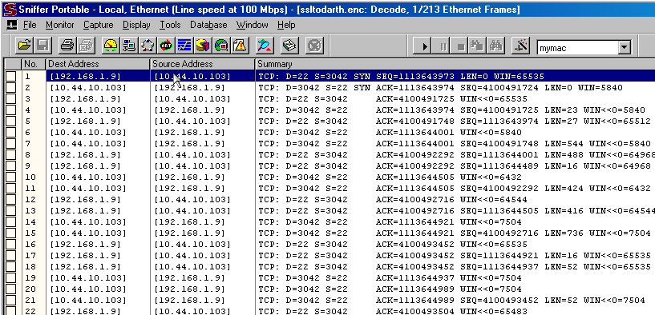
NAI Sniffer Pro v 4.70.553

Slide 4
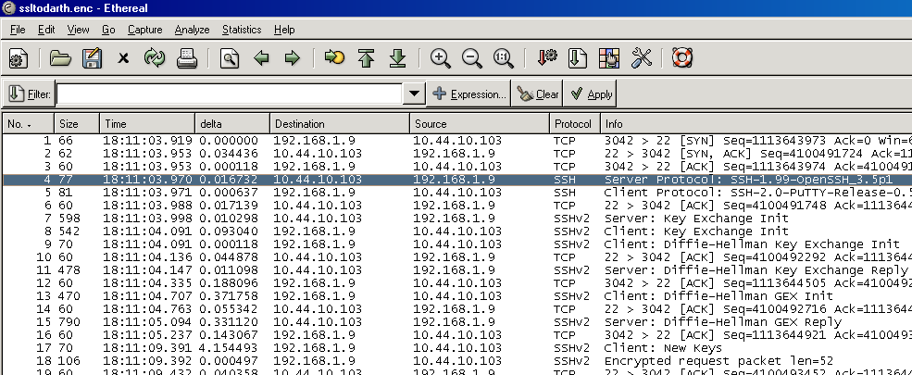
Ethereal v 0.10.6

Slide 5
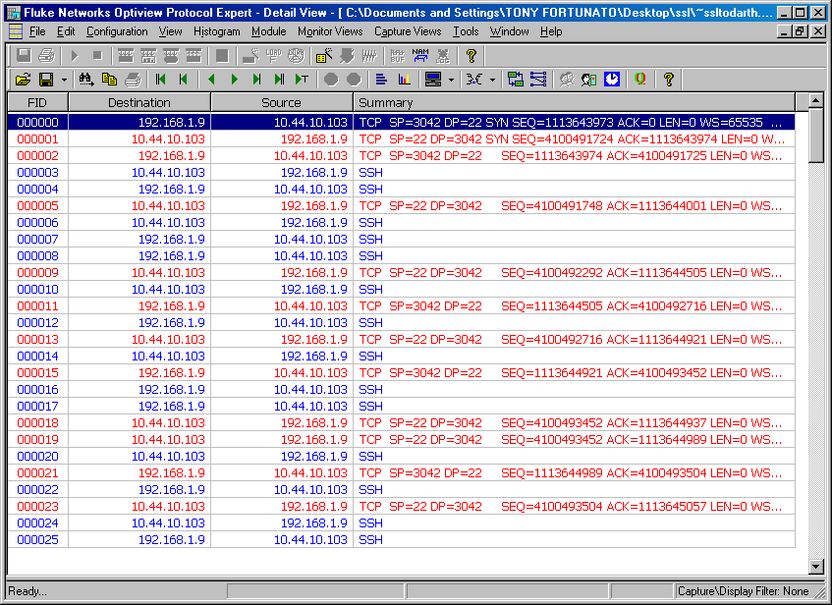
Fluke Optiview Protocol Expert v 6.1.0.13167.0

Slide 6
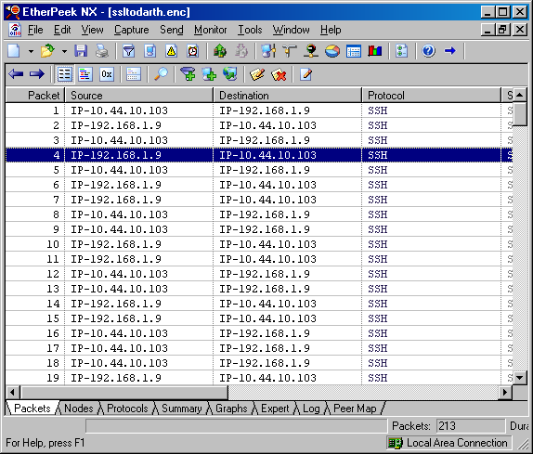
Wildpackets Etherpeek NX v 3.0.1

Slide 7
SSH Protocol

Slide 8
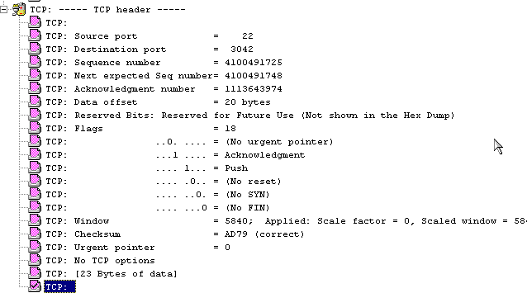
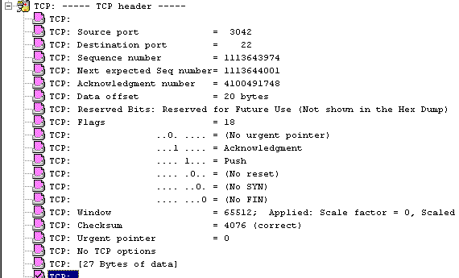
NAI Sniffer Pro v 4.70.553
Server Protocol
Client Protocol

Slide 9
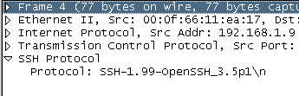
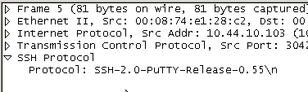
Ethereal v 0.10.6
Server Protocol
Client Protocol

Slide 10

Fluke Optiview Protocol Expert v 6.1.0.13167.0
Server Protocol
Client Protocol

Slide 11


Wildpackets Etherpeek NX v 3.0.1
Server Protocol
Client Protocol

Slide 12
SSH Key Exchange

Slide 13
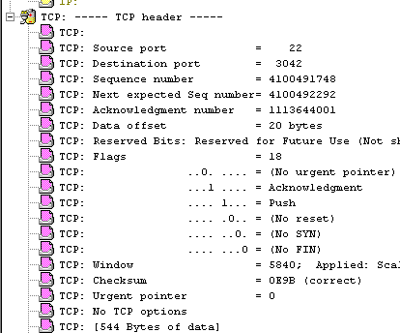
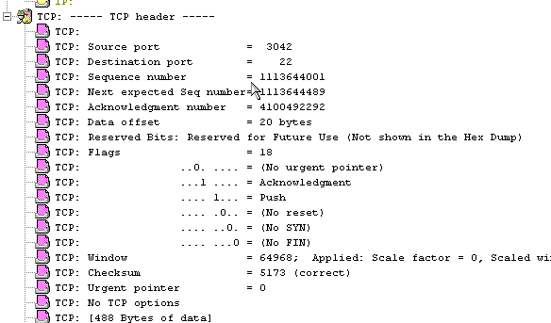
NAI Sniffer Pro v 4.70.553
Server
Client

Slide 14
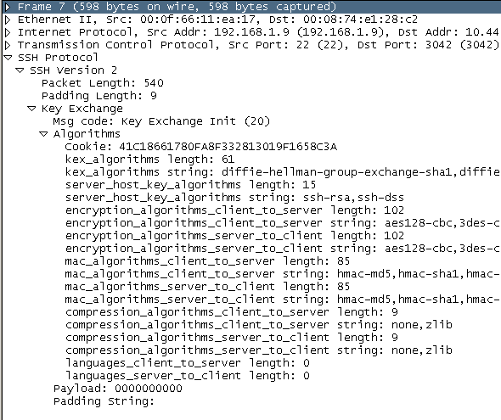
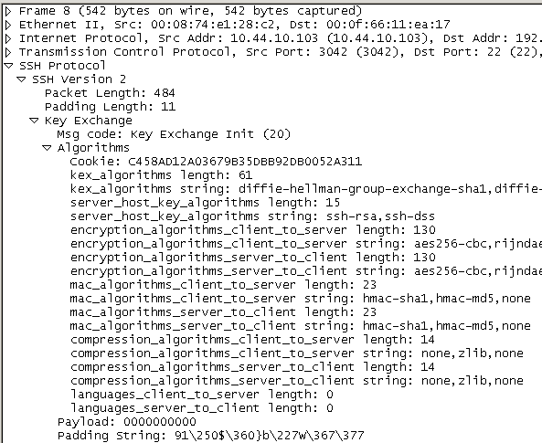
Ethereal v 0.10.6
Server
Client

Slide 15

Fluke Optiview Protocol Expert v 6.1.0.13167.0
Server
Client

Slide 16
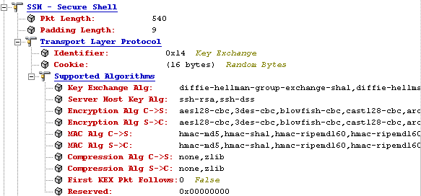
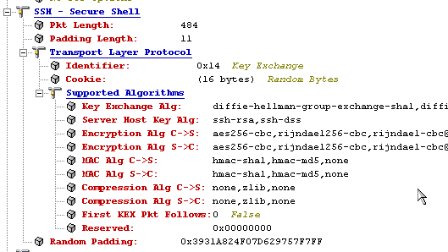
Wildpackets Etherpeek NX v 3.0.1
Server
Client

